Slide 1

Predicting Opioid Addiction Likelihood Using Neural Nets
Sam Blumer
Practicum II
Regis University

Slide 2
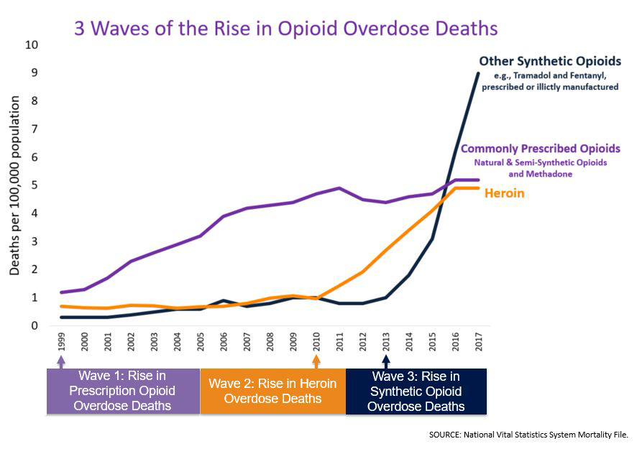
Opioid Addiction in the United States
From 1999 to 2017, more than 700,000 people have died from a drug overdose.
Around 68% of the more than 70,200 drug overdose deaths in 2017 involved an opioid.
On average, 130 Americans die every day from an opioid overdose.
Source: https://www.cdc.gov/drugoverdose/epidemic/index.html

Slide 3
Data Science Process
Data Gathering
Data pre-processing
Data Exploration
Feature Engineering
Model building
Model refining
Model Results
Make Predictions
Prediction Results
Conclusion

Slide 4
Data Sources
National Institute on Drug Abuse
US Department of Health and Human Services
US National Library of Medicine
Institute for Social Research at the University of Michigan
American Association of Nurse Anesthetists
The Foundation for AIDS Research
The Treatment Episode Data Set -- Admissions (TEDS-A) is a national census data system of annual admissions to substance abuse treatment facilities. TEDS-A provides annual data on the number and characteristics of persons admitted to public and private substance abuse treatment programs that receive public funding.
Notes:
Took really 3-4 weeks to gather all data.

Slide 5
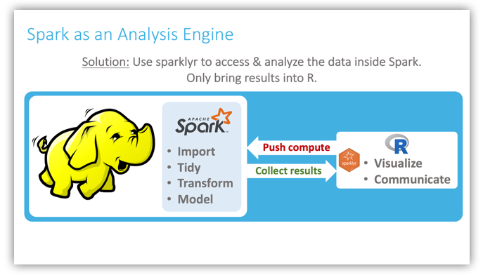
Pre-Processing
Use Sparklyr for processing
Import files
Aggregate and flatten files
Update data types
Missing Data
Source: https://spark.rstudio.com/guides/data-lakes/

Slide 6
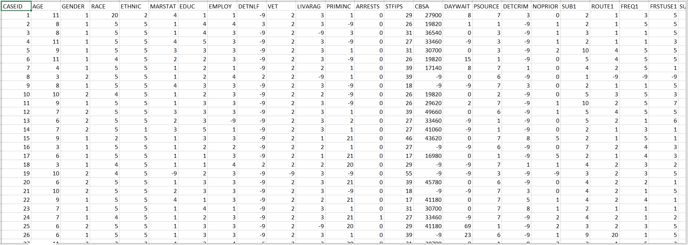

Slide 7
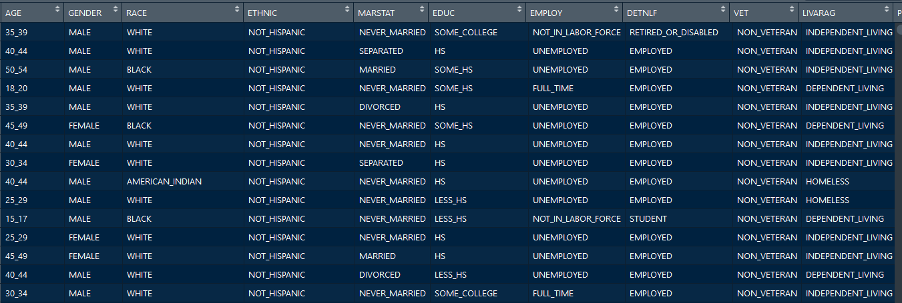

Slide 8
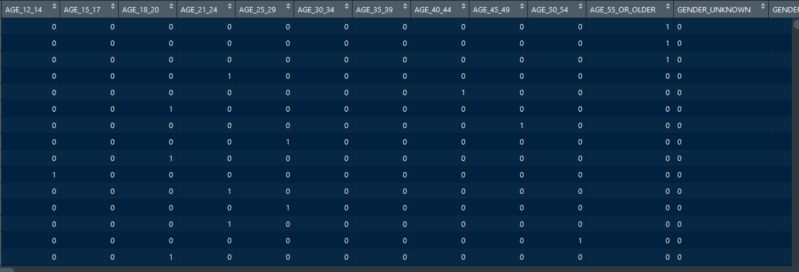

Slide 9
Data Exploration
Overdose Deaths Over Time
Demographic Characteristics
Substance Abuse Traits

Slide 10
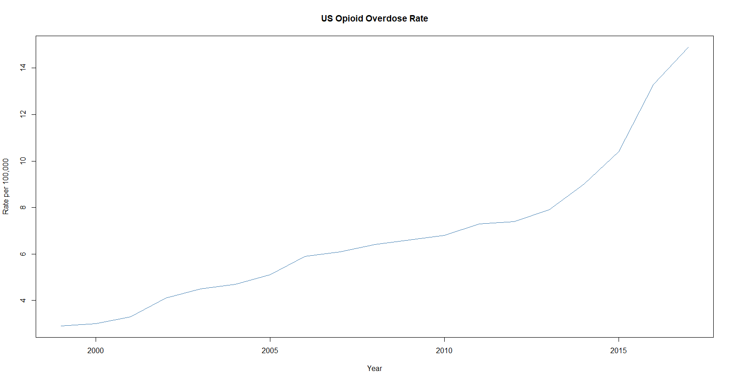
Overdose rates between 1999-2017
Increased OD rates across the board, more prominent in Midwest states like WV, OH, and NH.
Source: Henry J Kaiser Family Foundation

Slide 11
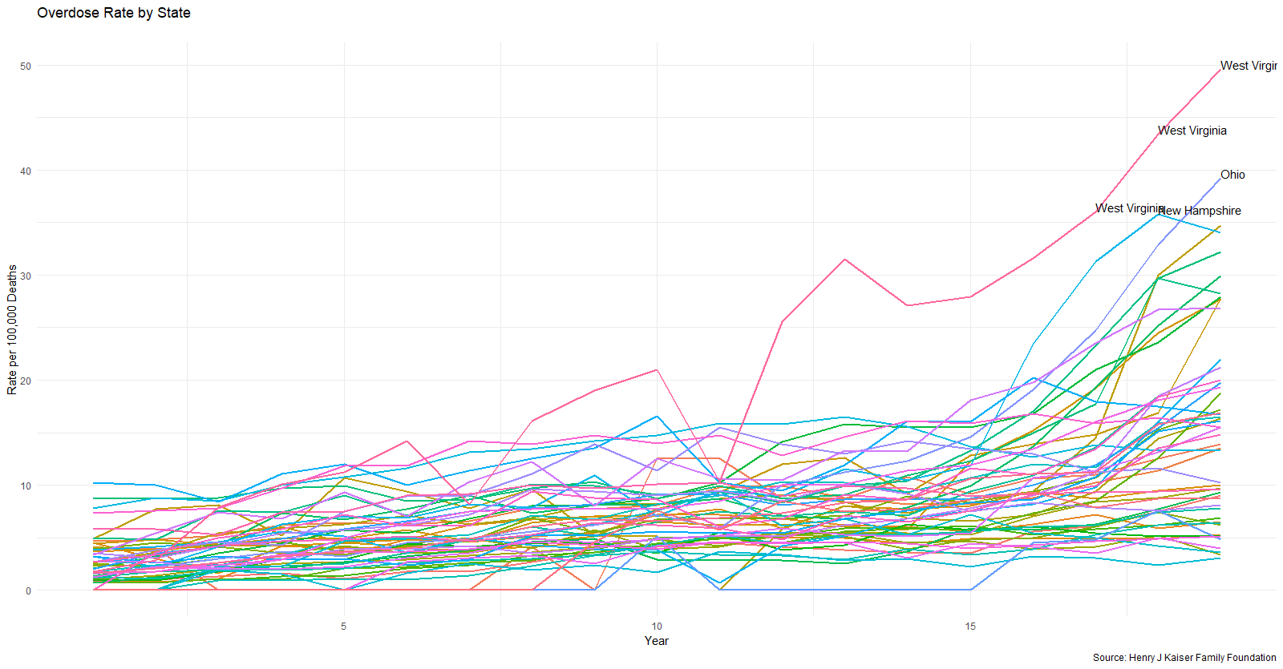
Overdose rates between 1999-2017
Increased OD rates across the board, more prominent in Midwest states like WV, OH, and NH.
Source: Henry J Kaiser Family Foundation

Slide 12
Overall Admission Data
Metric | Measure
Males | 66%
Female | 33%
White | 66 %
Black | 20%
HS or Less | 74%
Unemployed/Not in Work Force | 76%
Primary Income from Wages | 17.5%
Diagnosed Psychological Problem | 24%
Admitted Under Age 35 | 55%
First Substance Use Under Age 20 | 74%

Slide 13
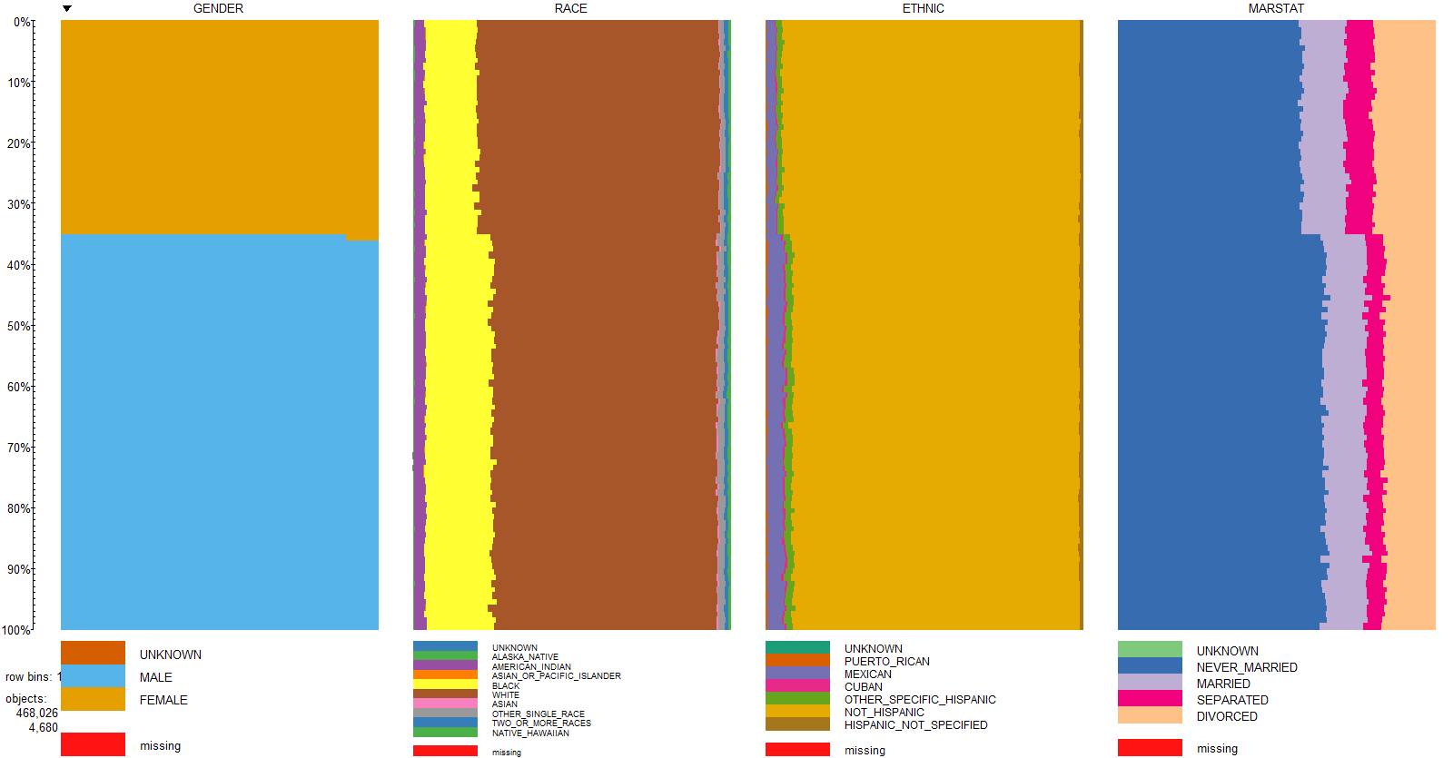

Slide 14
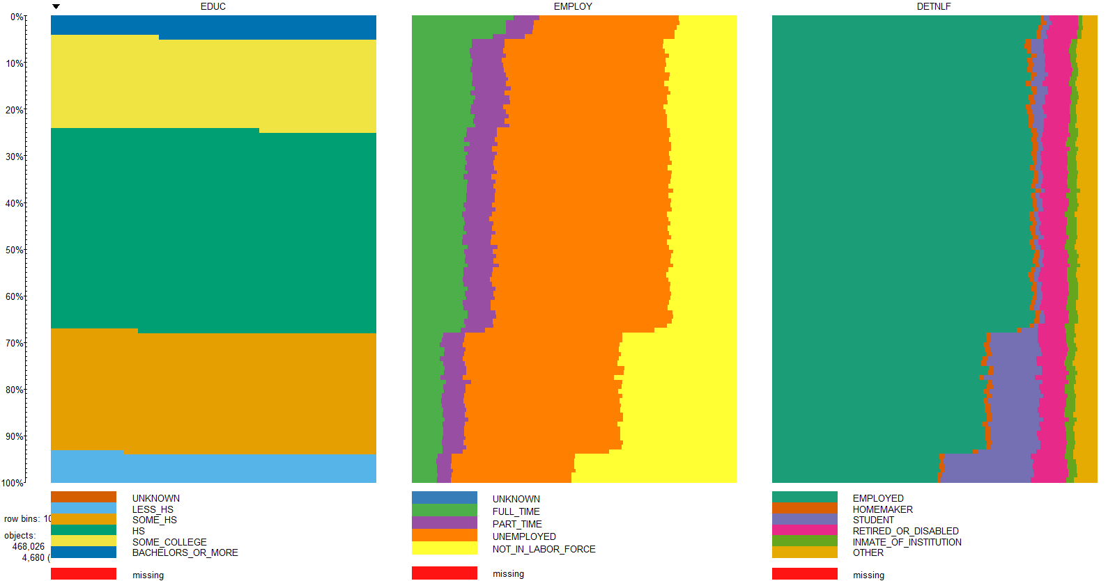

Slide 15
Substance Data
Substance Name | Primary Substance | Secondary Substance | Tertiary Substance | Total Number | Percent of Patients
HEROIN | 251,519 | 40,319 | 14,783 | 306,621 | 17.55%
OTHER OPIATES AND SYNTHETICS | 151,328 | 79,390 | 32,451 | 263,169 | 15.07%
COCAINE OR CRACK | 109,927 | 167,902 | 73,447 | 351,276 | 20.11%
METHAMPHETAMINE | 71,172 | 34,243 | 18,023 | 123,438 | 7.07%
BENZODIAZEPINES | 16,403 | 52,995 | 31,586 | 100,984 | 5.78%
NONE | 14,251 | 667,713 | 149,801 | 831,765 | 47.62%
OTHER | 9,186 | 32,280 | 22,212 | 63,678 | 3.65%
OTHER AMPHETAMINES | 7,376 | 7,435 | 6,809 | 21,620 | 1.24%
PCP | 5,155 | 3,293 | 2,160 | 10,608 | 0.61%
NON-PRESCRIPTION METHADONE | 5,108 | 4,167 | 2,143 | 11,418 | 0.65%
OTHER NON-BARBITURATE SEDATIVES OR HYPNOTICS | 2,344 | 4,363 | 3,067 | 9,774 | 0.56%
OTHER HALLUCINOGENS | 1,886 | 3,426 | 5,199 | 10,511 | 0.60%
UNKNOWN | 1,104 | 3,676 | 207,386 | 212,166 | 12.15%
INHALANTS | 1,001 | 906 | 1,006 | 2,913 | 0.17%
OVER THE COUNTER MEDICATIONS | 968 | 1,319 | 1,097 | 3,384 | 0.19%
OTHER STIMULANTS | 909 | 1,238 | 1,170 | 3,317 | 0.19%
BARBITURATES | 673 | 783 | NA | 1,456 | 0.08%
OTHER NON-BENZODIAZEPINE TRANQUILIZERS | 336 | 764 | 717 | 1,817 | 0.10%

Slide 16
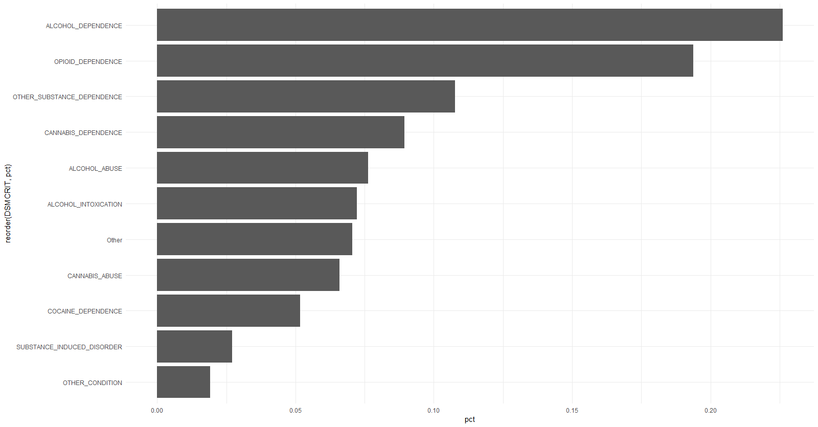
Diagnosis Upon Admission

Slide 17
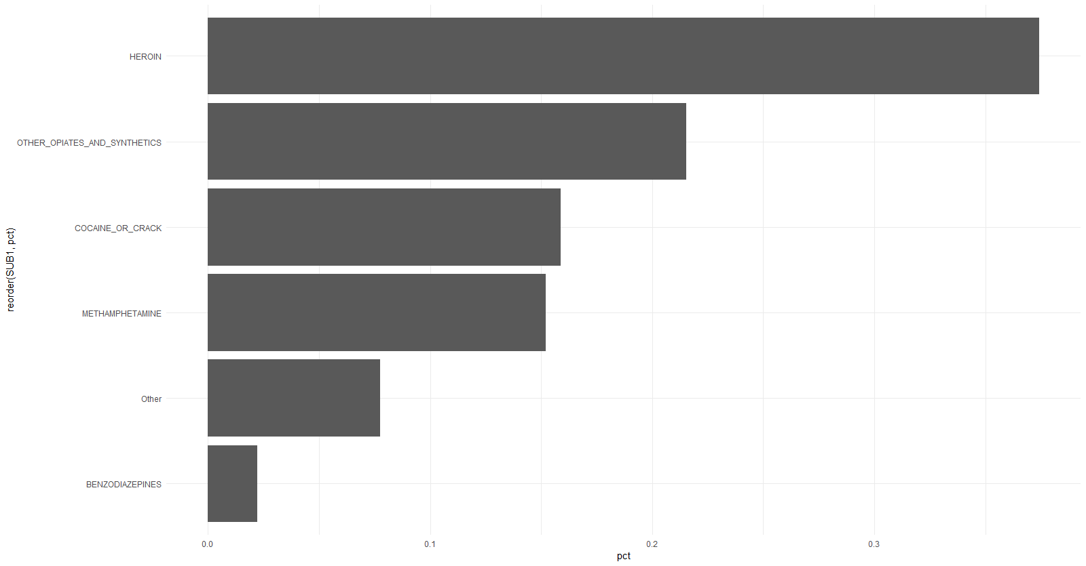
PRIMARY SUBSTANCE IN BODY UPON ADMISSION
EXCLUDING MARIJUANA AND ALCOHOL

Slide 18
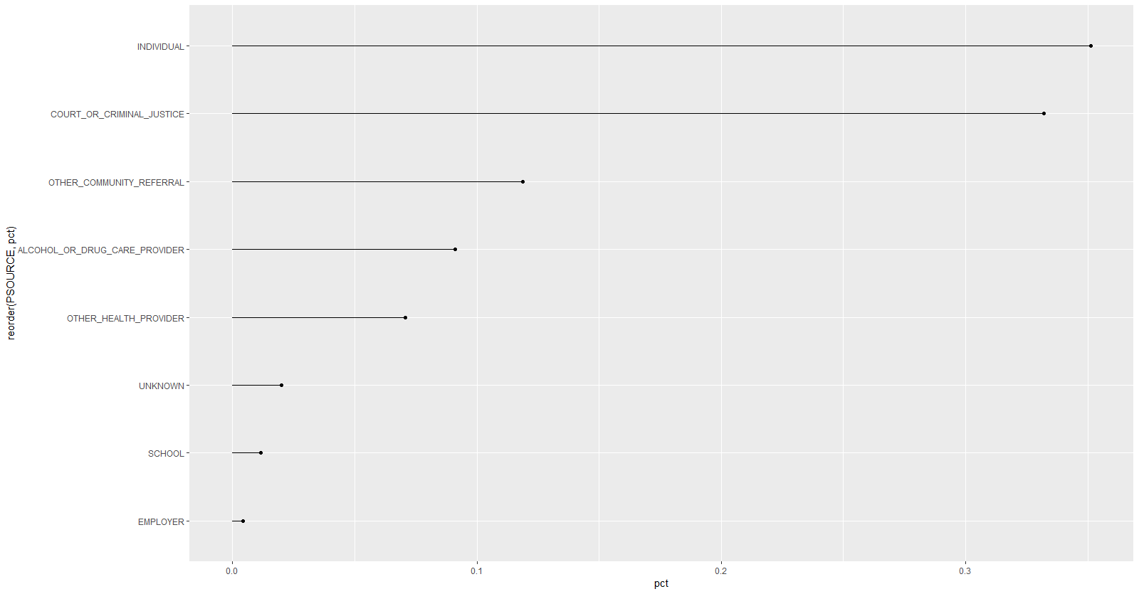
WHO ADMITTED THE PATIENT

Slide 19
Admission Data for Opiate Users
Metric | Measure
Males | 59%
Female | 41%
White | 77%
Black | 9%
HS or Less | 75%
Unemployed/Not in Work Force | 82%
Primary Income from Wages | 12%
Diagnosed Psychological Problem | 26%
Admitted Under Age 35 | 62%
First Substance Use Under Age 20 | 56%

Slide 20
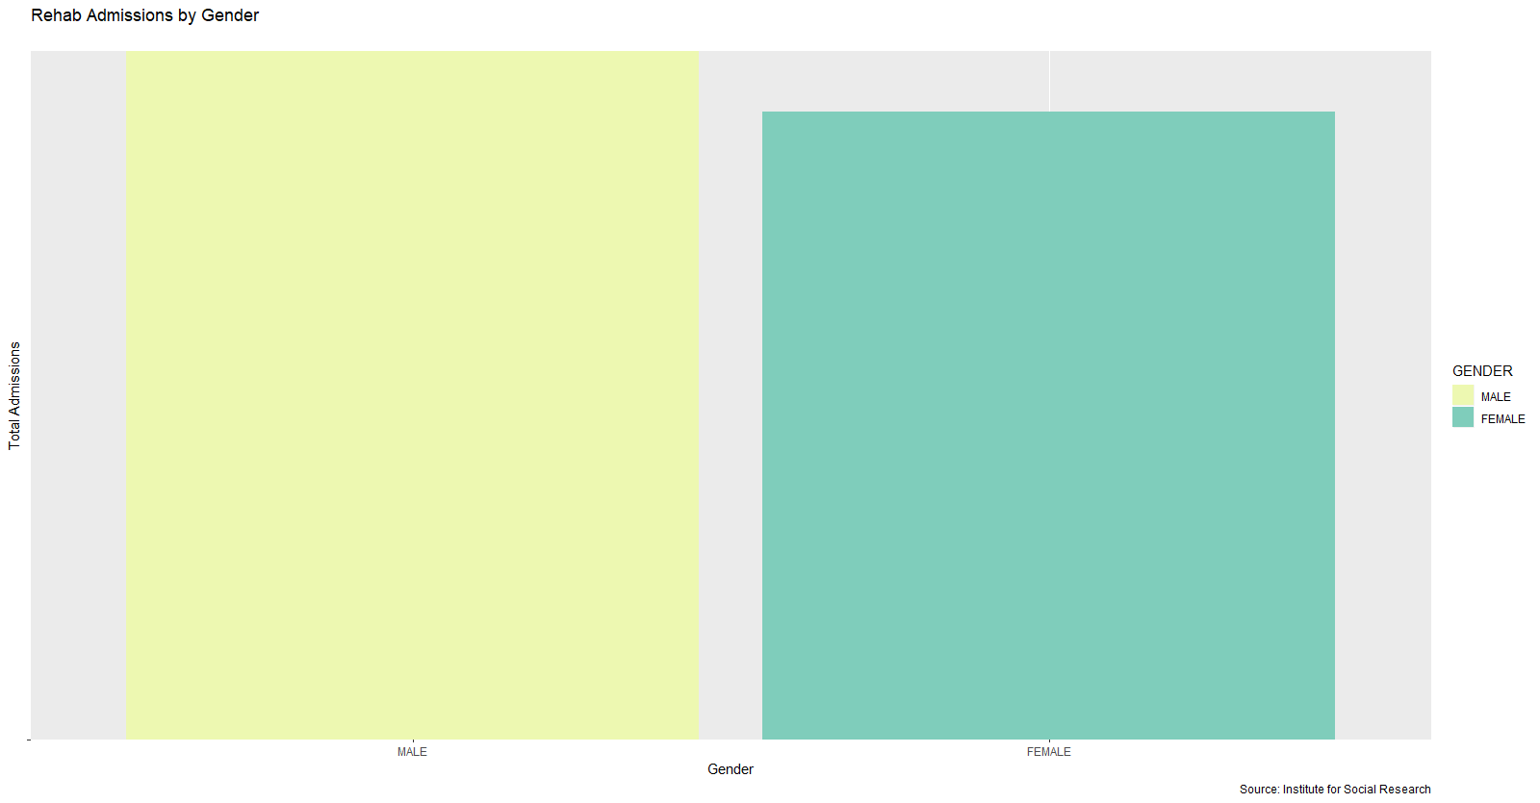

Slide 21
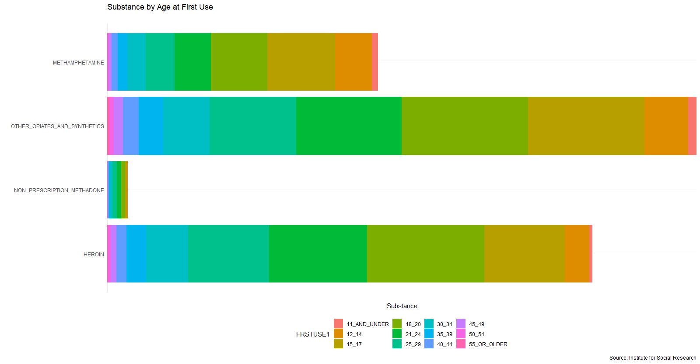

Slide 22
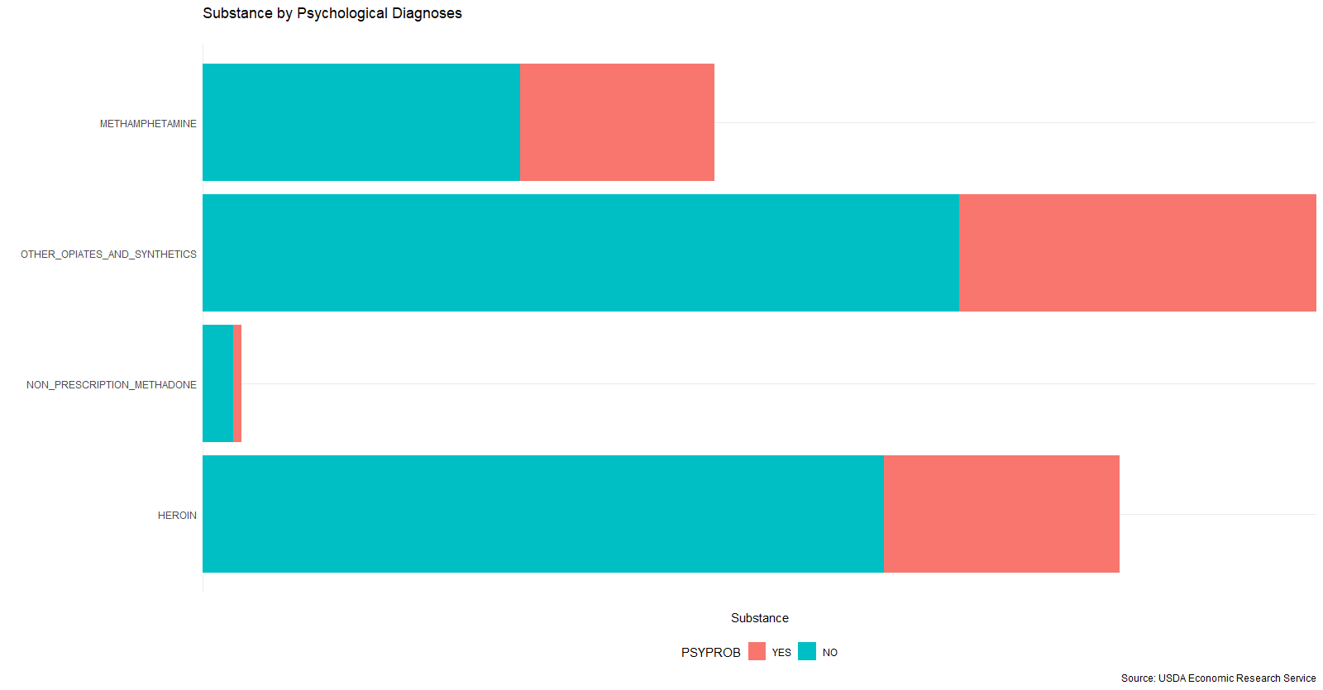

Slide 23
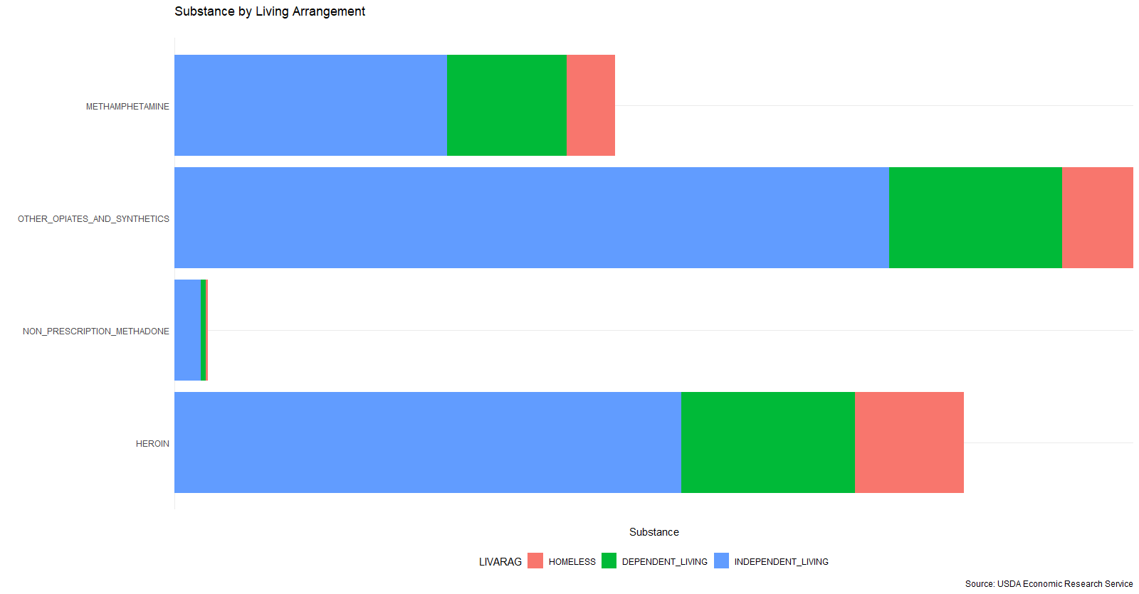

Slide 24
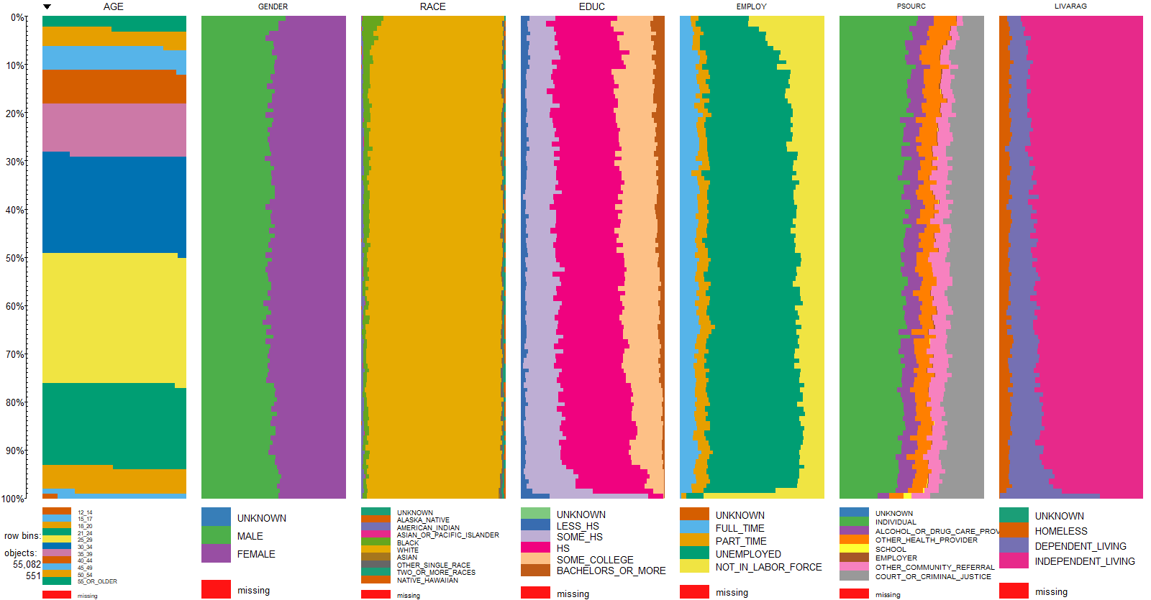

Slide 25
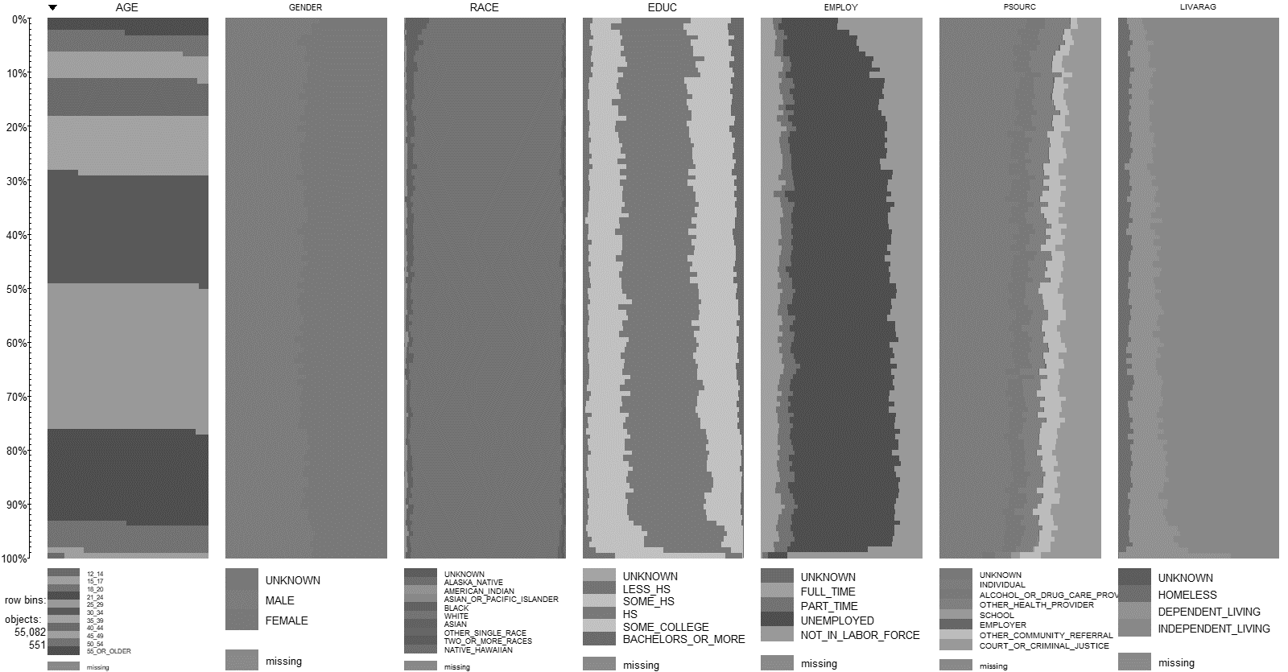
Opiate User Summary
While all substance admission data tended to have twice the number of males, strictly opiate users tended to be equally female and male.
White
Unemployed
High School Education
Independent Living
Started using between 15 – 24

Slide 26
Feature Engineering
30 Initial Variables
1 response (Opioid Abuse Diagnoses per DSM)
29 predictors
Use of One-Hot Encoding
Turns each categorical variable into its own column
181 total variables
1,749,767 x 181 = 316,707,827 total data points
Remove rows with any unknown values (can’t impute factors) = 468,026
Ultimately, based off processing and model complexity, used a sample size of 10,000

Slide 27
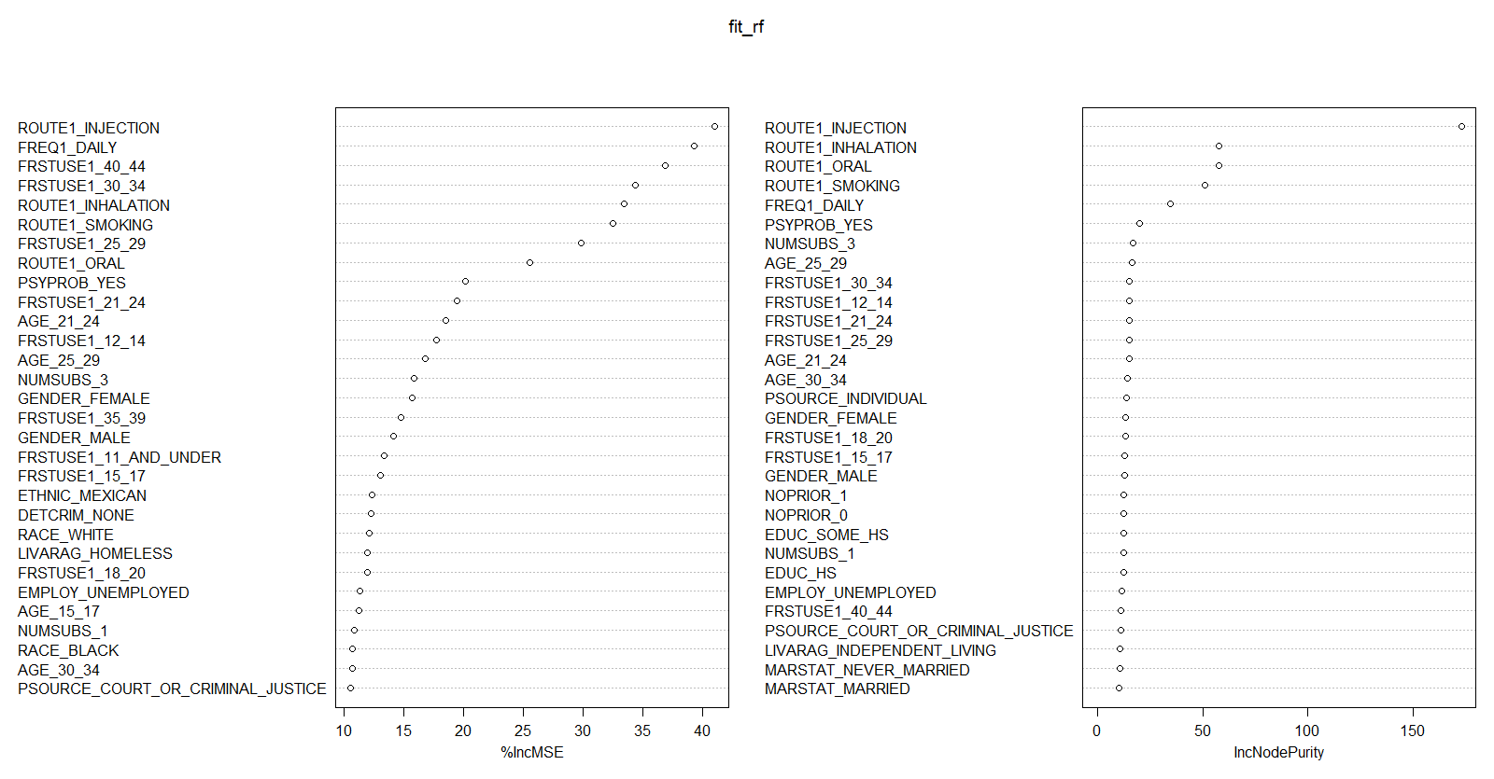
Random Forest Variable Importance
Notes:
The first graph shows that if a variable is assigned values by random permutation by how much will the MSE increase. So in your case if you randomly permute the year (i.e. an observation which had year =2014 but you randomly assign the year = 2012 (if that is present in your bagged sample) and so on) the MSE will increase by 100% on an average. Which make sense that bike demand may have increased in recent years. Higher the value, higher the variable importance.

Slide 28
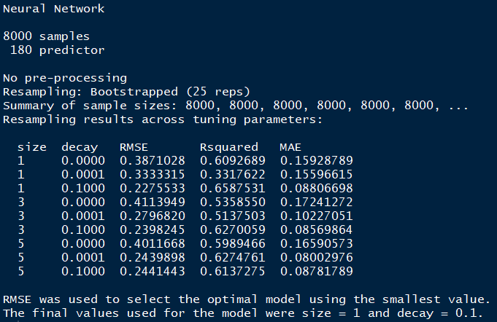
Model Building
What did we use
NN1: 2-Hidden Layers - Layer-1: 1-neuron, Layer-2: 1-neuron
NN2: 2-Hidden Layers - Layer-1: 2-neurons, Layer-2: 1-neuron
NN3: 2-Hidden Layers, Layer-1: 2-neurons, Layer-2: 2-neurons
NN4: 2-Hidden Layers, Layer-1: 1-neuron, Layer-2: 2-neurons

Slide 29
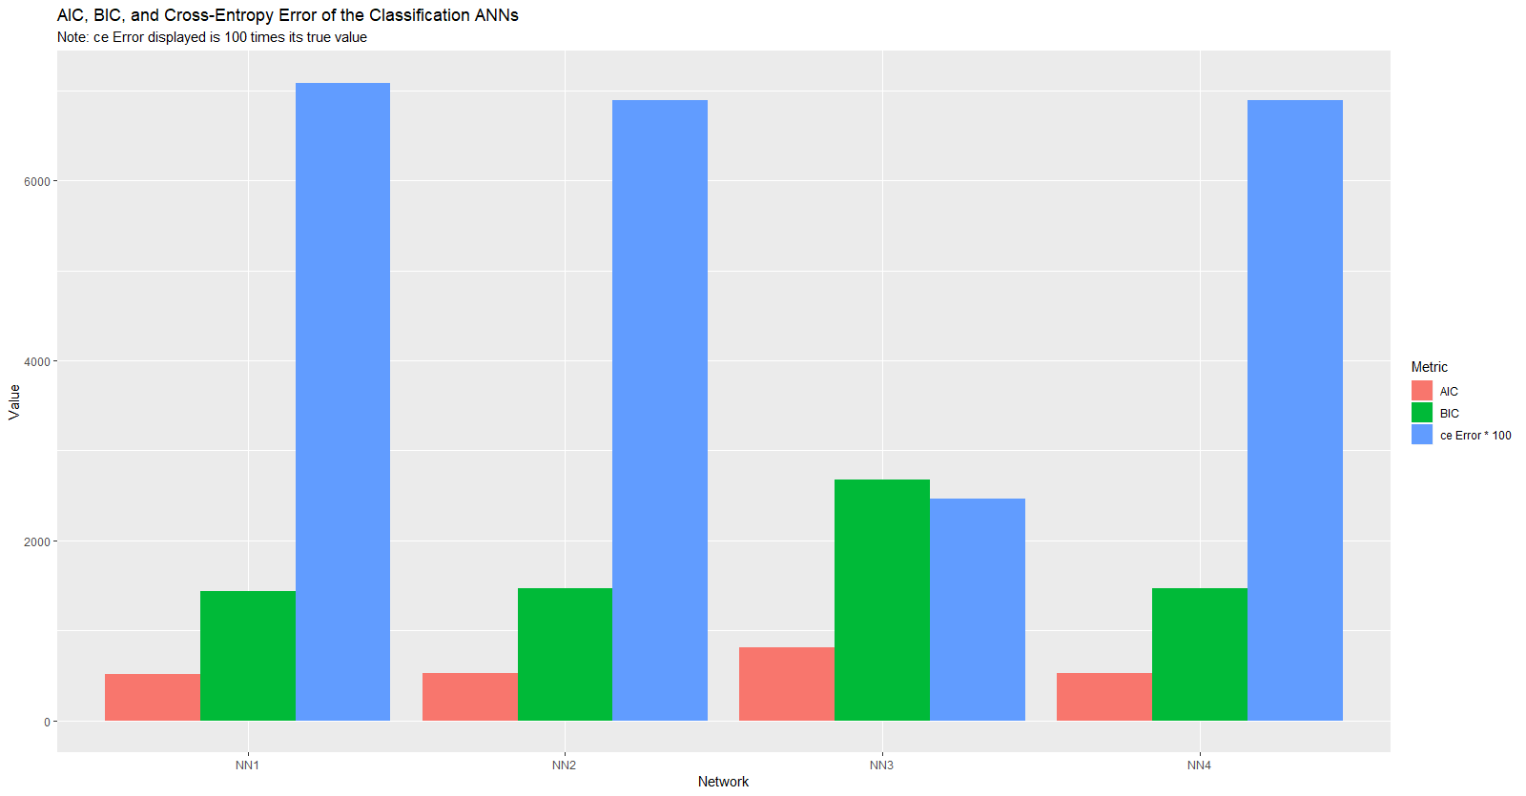

Slide 30
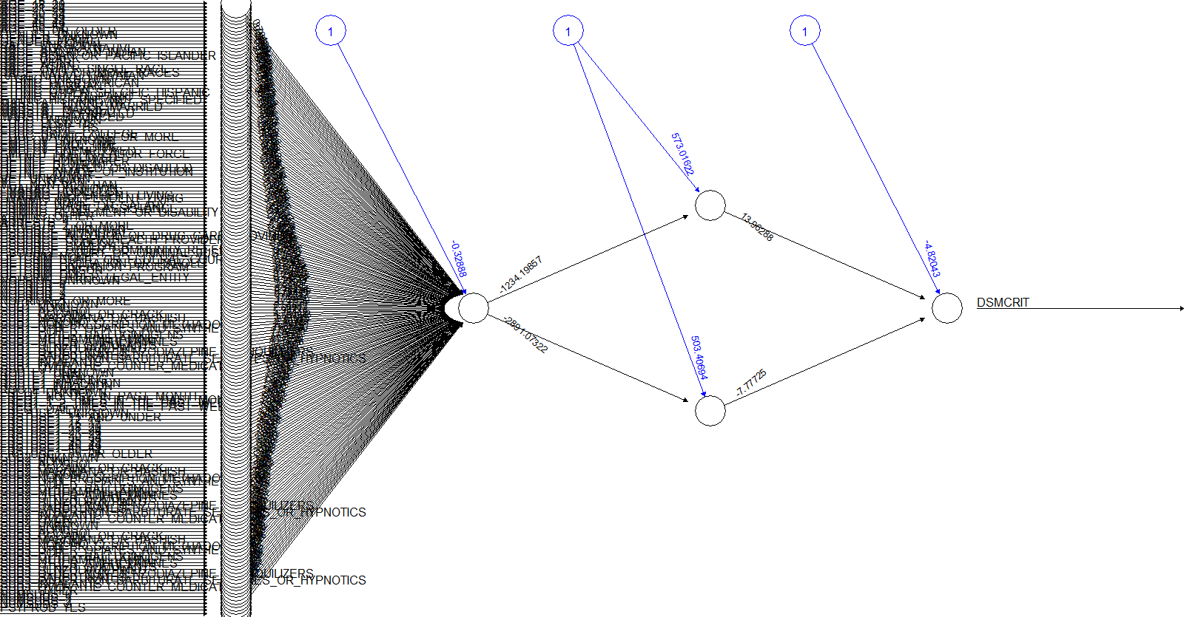

Slide 31
Model Results (NN3)
Accuracy = (1520 + 358)/2000 = .94
Recall = 1520 / (1520 +38) = .98
Precision = 1520 / (1520 + 84) = .95
 | Predictions
Actuals | 0 | 1
0 | 1,520 | 84
1 | 38 | 358

Slide 32
Conclusion
Using all 180 one-hot encoded variables, our most accurate model was NN3, which consisted of 2 hidden layer, both of which had 2 neurons.
Accuracy = 94% Recall = 98% Precision = 95%
Biggest indicators of addiction likelihood:
White
Male
Unemployed
Route of Drug Administration
Age at First Use
Other Substance Use

